Slide 1
Reminders
Homework 9 or Project Milestone 1 are due tonight by 11:59pm
HW10 on Neural Machine Translation will be released soon. Milestone 2 is ready.
Quiz on Chapter 28 is due Monday.

Slide 2
Encoder-Decoder Models
Jurafsky and Martin Chapter 10

Slide 3
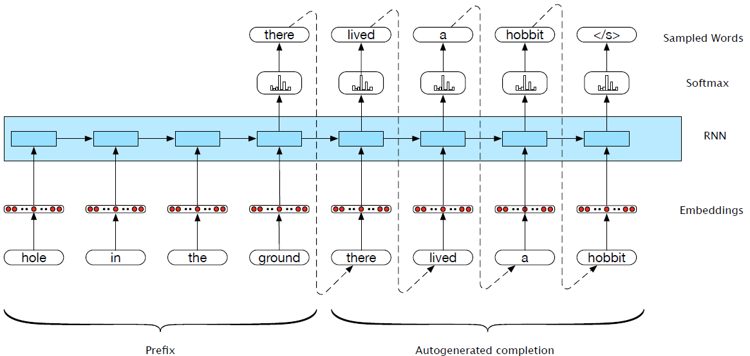
Generation with prefix
Notes:
What about generating from a specified prefix?
Now, let’s consider a simple variation on auto-regressive generation scheme. Instead of having the language model generate a sentence from scratch, we have it complete a sequence given a specified prefix. More specifically, we first pass the specified prefix through the language model using forward inference to produce a sequence of hidden states, ending with the hidden state corresponding to the last word of the prefix. We then begin generating as we did earlier, but using the final hidden state of the prefix as our starting point. The result of this process is a novel output sequence that should
be a reasonable completion of the prefix input.

Slide 4
Machine Translation (MT)
MT is the task of automatically translating sentences from one language into another.
We use bilingual parallel texts to train MT systems – pairs of source-target sentences that are translations of each other.
To extend LMs and autoregressive generation to MT, we will:
Add an end-of-sentence marker to each source sentence. Concatenate the target sentence to it.
Train an RNN LM based on this combined data.
To translate, simply treat the input sentence as a prefix, create a hidden state representation for it (encoding step).
Use the hidden state produced by the encoder to then start generating (decoding step)
Notes:
To translate a source text using the trained model, we run it through the network performing forward inference to generate hidden states until we get to the end of the source. Then we begin autoregressive generation, asking for a word in the context of the hidden layer from the end of the source input as well as the end-of-sentence marker. Subsequent words are conditioned on the previous hidden state and the embedding for the last word generated.

Slide 5
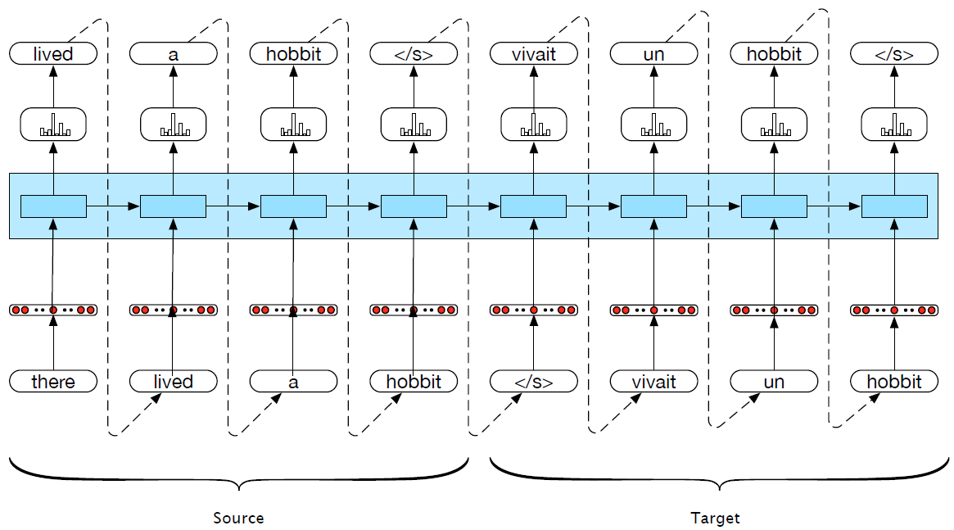
Machine translation

Slide 6
Encoder-Decoder Networks
We can abstract away from the task of MT to talk about the general encoder-decoder architecture:
An encoder takes an input sequence x^{n}_{1,} and generates a corresponding sequence of contextualized representations, h^{n}₁.
A context vector, c, is a function of h^{n}₁, and conveys the essence of the input to the decoder.
A decoder accepts c as input and generates an arbitrary length sequence of hidden states h^{m}₁ , from which can be used to create a corresponding sequence of output states y^{m}₁ .
Notes:
An encoder takes an input sequence x^{n}_{1,} and generates a corresponding sequence of contextualized representations, h^{n}₁.
A context vector, c, is a function of h^{n}₁, and conveys the essence of the input to the decoder.
A decoder accepts c as input and generates an arbitrary length sequence of hidden states h^{m}₁ , from which can be used to create a corresponding sequence of output states y^{m}₁ .

Slide 7
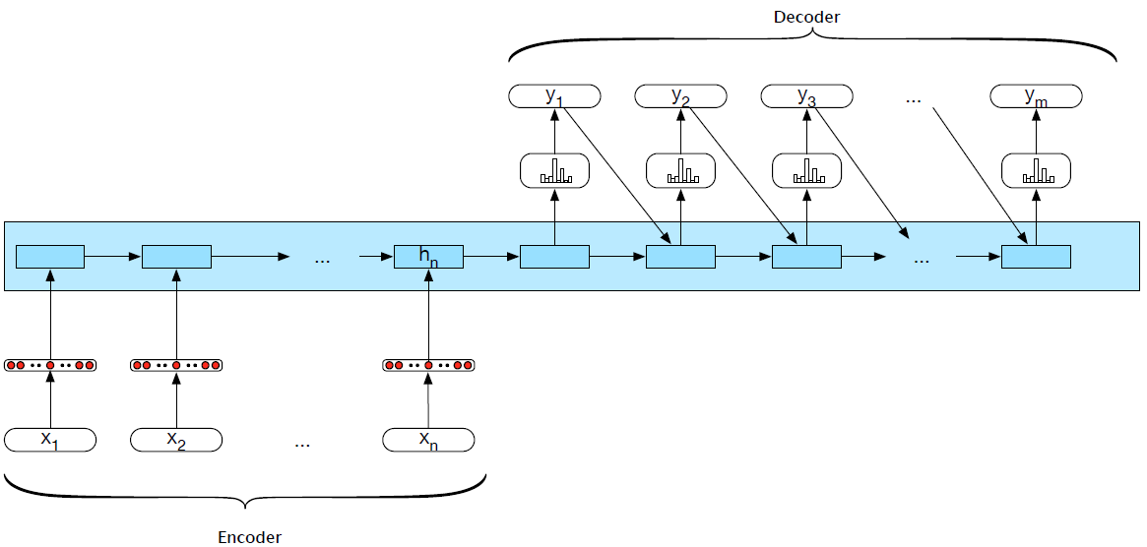
Encoder-decoder networks
Notes:
This basic architecture is consistent with the original applications of neural mod- els to machine translation. However, it embodies a number of design choices that are less than optimal. Among the major ones are that the encoder and the decoder are assumed to have the same internal structure (RNNs in this case), that the final state of the encoder is the only context available to the decoder, and finally that this context is only available to the decoder as its initial hidden state

Slide 8
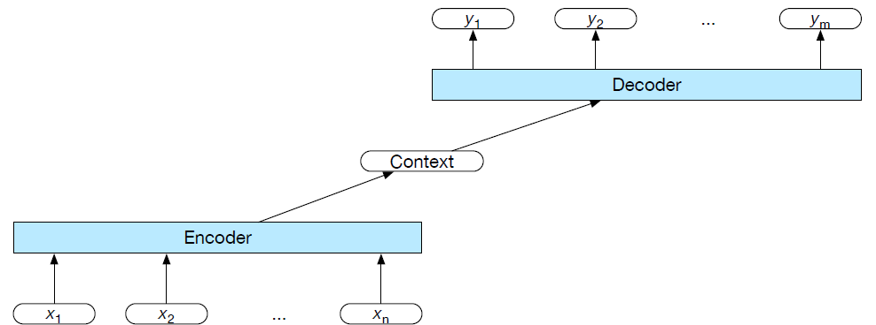
Encoder-decoder networks
An encoder that accepts an input sequence and generates a corresponding sequence of contextualized representations
A context vector that conveys the essence of the input to the decoder
A decoder, which accepts context vector as input and generates an arbitrary length sequence of hidden states, from which a corresponding sequence of output states can be obtained

Slide 9
Encoder
Pretty much any kind of RNN or its variants can be used as an encoder. Researchers have used simple RNNs, LSTMs, GRUs, or even convolutional networks.
A widely used encoder design makes use of stacked Bi-LSTMs where the hidden states from top layers from the forward and backward passes are concatenated

Slide 10
Stacked RNNs
Notes:
Stacked RNNs consist of multiple networks where the output of one layer serves as the input to a subsequent layer,
It has been demonstrated across numerous tasks that stacked RNNs can outper- form single-layer networks. One reason for this success has to do with the network’s ability to induce representations at differing levels of abstraction across layers. Just as the early stages of the human visual system detect edges that are then used for finding larger regions and shapes, the initial layers of stacked networks can induce representations that serve as useful abstractions for further layers — representations that might prove difficult to induce in a single RNN.

Slide 11
Bidirectional RNNs

Slide 12
Decoder
For the decoder, autoregressive generation is used to produce an output sequence, an element at a time, until an end-of-sequence marker is generated.
This incremental process is guided by the context provided by the encoder as well as any items generated for earlier states by the decoder.
Encoder
Decoder
Notes:
Recall, that g is a stand-in for some flavor of RNN and y_t−1 is the embedding for the output sampled from the softmax at the previous step

Slide 13
Decoder Weaknesses
In early encoder-decoder approaches, the context vector c was only directly available at the beginning of the generation process.
This meant that its influence became less-and-less imporant as the output sequence was generated.
One solution is to make c available at each step in the decoding process, when generating the hidden states in the deocoder
and while producing the generated output.
Notes:
adding it as a parameter to the computation of the current
Beam Search
A common approach to the calculation of the output layer y is to base it solely on this newly computed hidden state. While this cleanly separates the underlying recurrence from the output generation task, it makes it difficult to keep track of what has already been generated and what hasn’t. A alternative approach is to condition the output on both the newly generated hidden state, the output generated at the previous state, and the encoder context.
y =softmax(yˆ ,z,c) t t−1 t
Finally, as shown earlier, the output y at each time consists of a softmax computa- tion over the set of possible outputs (the vocabulary in the case of language models). What one does with this distribution is task-dependent, but it is critical since the re- currence depends on choosing a particular output, yˆ, from the softmax to condition the next step in decoding. We’ve already seen several of the possible options for this. For neural generation, where we are trying to generate novel outputs, we can sim- ply sample from the softmax distribution. However, for applications like MT where we’re looking for a specific output sequence, random sampling isn’t appropriate and would likely lead to some strange output. An alternative is to choose the most likely output at each time step by taking the argmax over the softmax output:
yˆ = argmaxP(yi|y<i)
This is easy to implement but as we’ve seen several times with sequence labeling, independently choosing the argmax over a sequence is not a reliable way of arriving at a good output since it doesn’t guarantee that the individual choices being made make sense together and combine into a coherent whole. With sequence labeling we addressed this with a CRF-layer over the output token types combined with a Viterbi- style dynamic programming search. Unfortunately, this approach is not viable here since the dynamic programming invariant doesn’t hold.
Beam Search
A viable alternative is to view the decoding problem as a heuristic state-space search and systematically explore the space of possible outputs. The key to such an ap- proach is controlling the exponential growth of the search space. To accomplish this, we’ll use a technique called beam search. Beam search operates by combin- ing a breadth-first-search strategy with a heuristic filter that scores each option and prunes the search space to stay within a fixed-size memory footprint, called the beam width.
At the first step of decoding, we select the B-best options from the softmax output y, where B is the size of the beam. Each option is scored with its corresponding probability from the softmax output of the decoder. These initial outputs constitute the search frontier. We’ll refer to the sequence of partial outputs generated along these search paths as hypotheses.
At subsequent steps, each hypothesis on the frontier is extended incrementally by being passed to distinct decoders, which again generate a softmax over the entire vocabulary. To provide the necessary inputs for the decoders, each hypothesis must include not only the words generated thus far but also the context vector, and the
hidden state.

Slide 14
Choosing the best output
For neural generation, where we are trying to generate novel outputs, we can simply sample from the softmax distribution.
In MT where we’re looking for a specific output sequence, sampling isn’t appropriate and would likely lead to some strange output.
Instead we choose the most likely output at each time step by taking the argmax over the softmax output

Slide 15
Beam search
In order to systematically explore the space of possible outputs for applications like MT, we need to control the exponential growth of the search space.
Beam search: combining a breadth-first-search strategy with a heuristic filter that scores each option and prunes the search space to stay within a fixed-size memory footprint, called the beam width

Slide 16
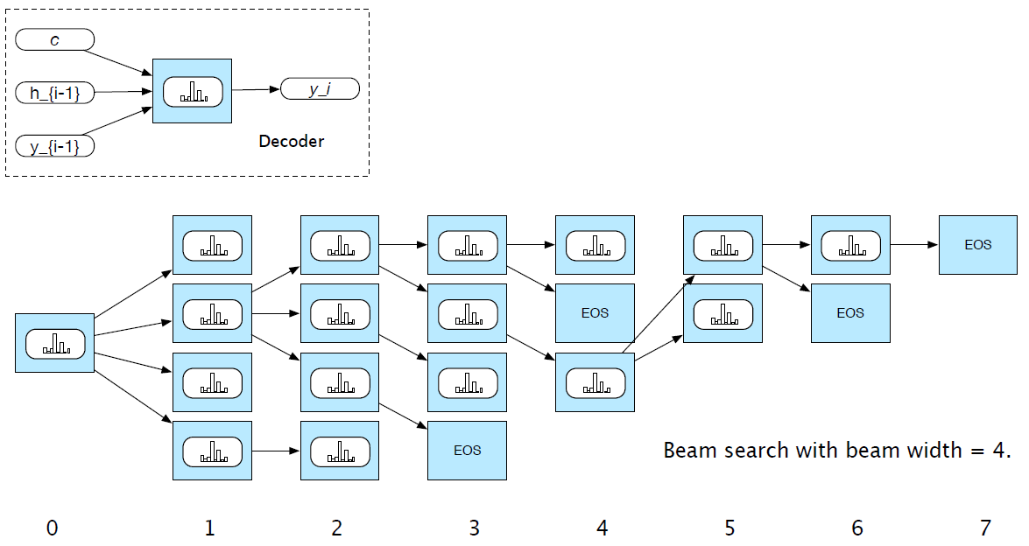
Beam search
Notes:
At the first step of decoding, we select the B-best options from the softmax output y, where B is the size of the beam. Each option is scored with its corresponding probability from the softmax output of the decoder. These initial outputs constitute the search frontier. We’ll refer to the sequence of partial outputs generated along these search paths as hypotheses.
At subsequent steps, each hypothesis on the frontier is extended incrementally by being passed to distinct decoders, which again generate a softmax over the entire vocabulary. no

Slide 17
Attention
Weaknesses of the context vector:
Only directly available at the beginning of the process and its influence will wane as the output sequence is generated
Context vector is a function (e.g. last, average, max, concatenation) of the hidden states of the encoder. This approach loses useful information about each of the individual encoder states
Potential solution: attention mechanism
Notes:
With this, we finally have a fixed-length context vector that takes into account information from the entire encoder state that is dynamically update to reflect the needs of the decoder at each step of decoding

Slide 18
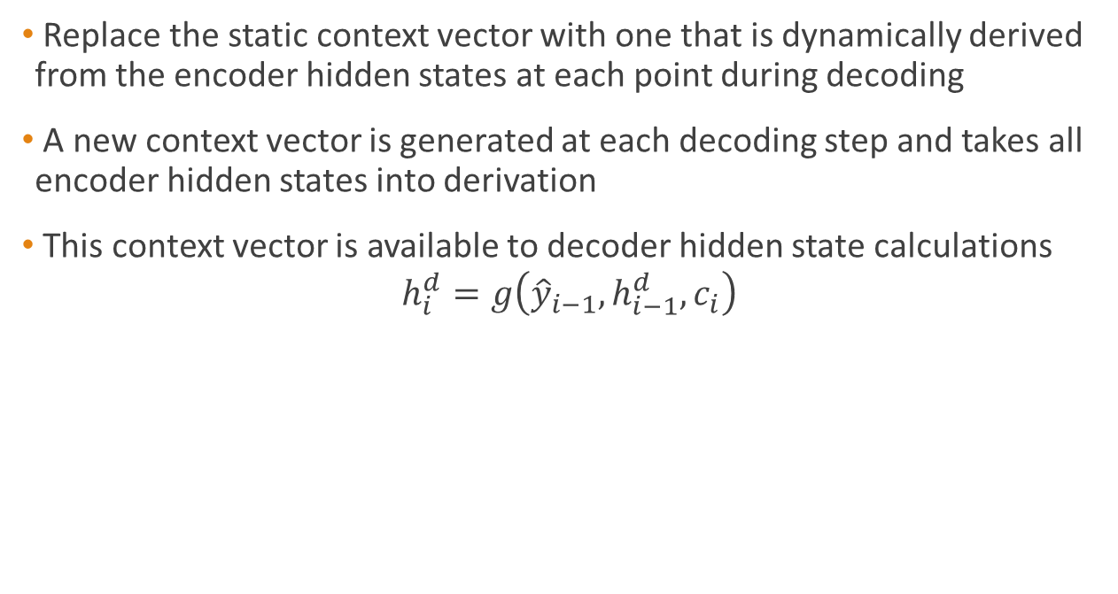
Attention
Replace the static context vector with one that is dynamically derived from the encoder hidden states at each point during decoding
A new context vector is generated at each decoding step and takes all encoder hidden states into derivation
This context vector is available to decoder hidden state calculations
$$h_{i}^{d}=g\left({\hat{y}}_{i−1},h_{i−1}^{d},c_{i}\right)$$

Slide 19
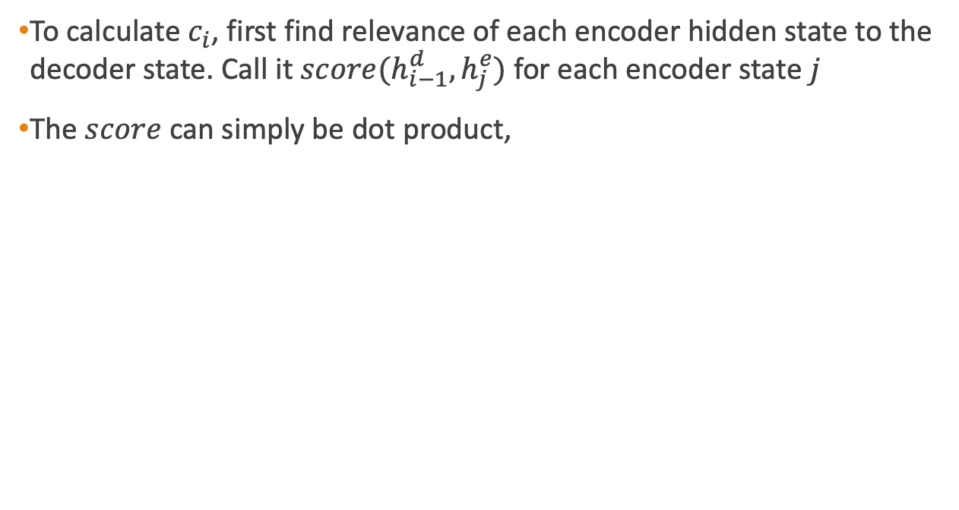
Attention
To calculate $c_{i}$, first find relevance of each encoder hidden state to the decoder state. Call it $score(h_{i−1}^{d},h_{j}^{e})$ for each encoder state $j$
The $score$ can simply be dot product,
Notes:
each encoder hidden state to the decoder state captured in hi−1.
h^d-1 = previous decoder state

Slide 20
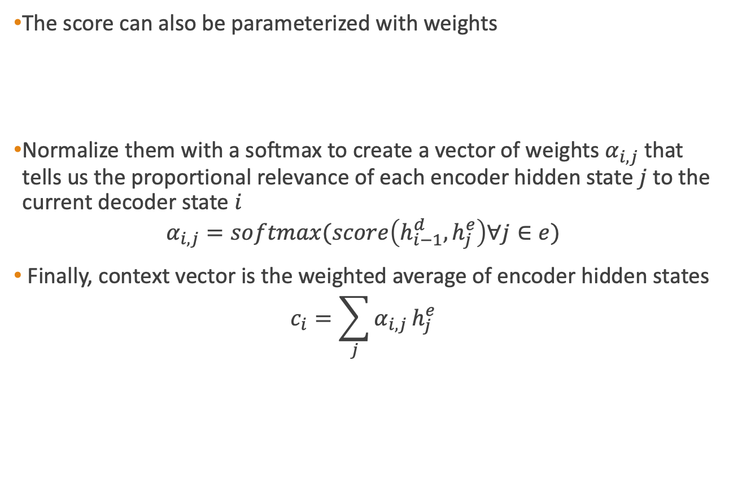
Attention
The score can also be parameterized with weights
Normalize them with a softmax to create a vector of weights $α_{i,j}$ that tells us the proportional relevance of each encoder hidden state $j$ to the current decoder state $i$
$$α_{i,j}=softmax(score\left(h_{i−1}^{d},h_{j}^{e}\right)∀j∈e)$$
Finally, context vector is the weighted average of encoder hidden states
$$c_{i}=\sum_{j}{α_{i,j}}h_{j}^{e}$$

Slide 21
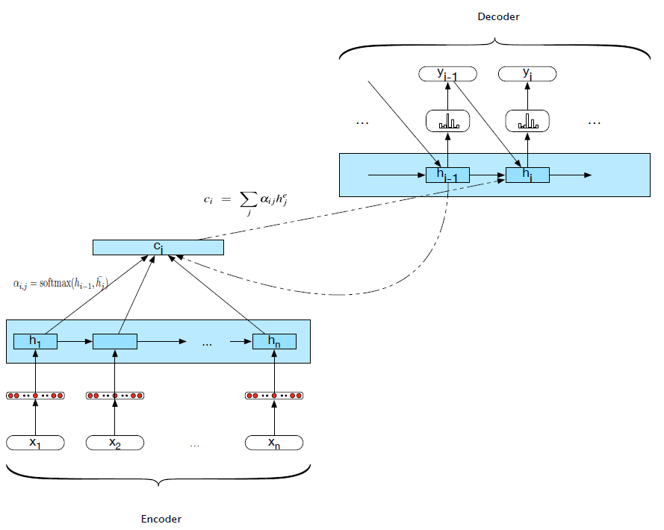
Attention mechanism

Slide 22
Applications of Encoder-Decoder Networks
Text summarization
Text simplification
Question answering
Image captioning
And more. What do those tasks have in common?

Slide 23
Neural Machine Translation
Slides from Graham Neubig, CMU
Neural Machine Translation and
Sequence-to-sequence Models: A Tutorial

Slide 24
Machine Translation
Translation from one language to another
ペンシルベニア大学で講演をしています。
I'm giving a talk at University of Pennsylvania

Slide 25
Review: Recurrent Neural Networks

Slide 26
Long-distance Dependencies
Agreement in number, gender, etc.
He does not have very much confidence in himself.
She does not have very much confidence in herself.
Selectional preference:
The reign has lasted as long as the life of the queen.
The rain has lasted as long as the life of the clouds.

Slide 27


Recurrent Neural Networks
Tools to “remember” information
Feed-forward NN
Recurrent NN
context
context
lookup
lookup
transform
transform
predict
predict
label
label

Slide 28
Unrolling in Time
What does processing a sequence look like?
I
hate
this
movie
RNN
RNN
RNN
RNN
predict
predict
predict
predict
label
label
label
label

Slide 29
Training RNNs
I
hate
this
movie
RNN
RNN
RNN
RNN
predict
predict
predict
predict
prediction 1
prediction 2
prediction 3
prediction 4
loss 1
loss 2
loss 3
loss 4
label 1
label 2
label 3
label 4
sum
total loss

Slide 30
Parameter Tying
Parameters are shared! Derivatives are accumulated.
I
hate
this
movie
RNN
RNN
RNN
RNN
predict
predict
predict
predict
prediction 1
prediction 2
prediction 3
prediction 4
loss 1
loss 2
loss 3
loss 4
label 1
label 2
label 3
label 4
sum
total loss

Slide 31
What Can RNNs Do?
Represent a sentence
Read whole sentence, make a prediction
Represent a context within a sentence
Read context up until that point

Slide 32
Representing Sentences
I
hate
this
movie
RNN
RNN
RNN
RNN
predict
prediction
Sentence classification
Conditioned generation
Retrieval

Slide 33
Representing Contexts
I
hate
this
movie
RNN
RNN
RNN
RNN
predict
predict
predict
predict
label
label
label
label
Tagging
Language Modeling
Calculating Representations for Parsing, etc.

Slide 34
Language Models
Language models are generative models of text
s ~ P(x)
“The Malfoys!” said Hermione.
Harry was watching him. He looked like Madame Maxime. When she strode up the wrong staircase to visit himself.
“I’m afraid I’ve definitely been suspended from power, no chance — indeed?” said Snape. He put his head back behind them and read groups as they crossed a corner and fluttered down onto their ink lamp, and picked up his spoon. The doorbell rang. It was a lot cleaner down in London.
Text Credit: Max Deutsch (https://medium.com/deep-writing/)

Slide 35
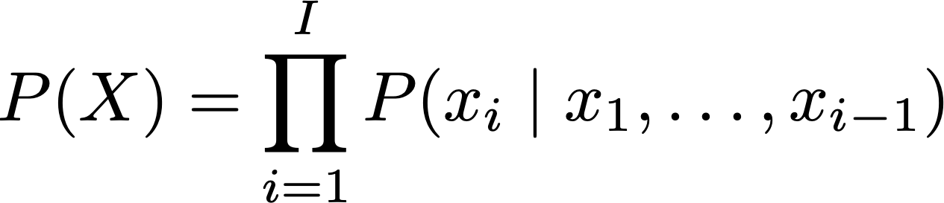
Calculating the Probability of a Sentence
Next Word
Context

Slide 36
Language Models with RNNs
<s>
I
hate
this
movie
RNN
RNN
RNN
RNN
RNN
predict
predict
predict
predict
predict
I
hate
this
movie
</s>
At each step, calculate probability of next word

Slide 37
Bi-directional RNNs
A simple extension, run the RNN in both directions
I
hate
this
movie
RNN
RNN
RNN
RNN
RNN
RNN
RNN
RNN
concat
concat
concat
concat
softmax
softmax
softmax
softmax
PRN
VB
DET
NN

Slide 38
Conditional Language Modeling for Machine Translation

Slide 39
Conditional Language Models
Not just generate text, generate text according to some specification
Input X
Output Y (Text)
Task
Structured Data
NL Description
NL Generation
English
Japanese
Translation
Document
Short Description
Summarization
Utterance
Response
Response Generation
Image
Text
Image Captioning
Speech
Transcript
Speech Recognition

Slide 40
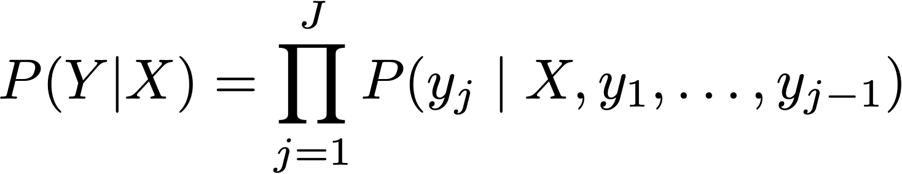
Conditional Language Models
Added Context!

Slide 41


One type of Conditional LM
Encoder
kono
eiga
ga
kirai
</s>
LSTM
LSTM
LSTM
LSTM
LSTM
I
hate
this
movie
LSTM
LSTM
LSTM
LSTM
argmax
argmax
argmax
argmax
argmax
I
hate
this
movie
</s>
Decoder
Sutskever et al. 2014

Slide 42
How to pass the hidden state?
Initialize decoder w/ encoder (Sutskever et al. 2014)
encoder
decoder
Transform (can be different dimensions)
encoder
transform
decoder
Input at every time step (Kalchbrenner & Blunsom 2013)
decoder
decoder
decoder
encoder

Slide 43
Training Conditional LMs
Get parallel corpus of inputs and outputs
Maximize likelihood
Standard corpora for MT:
WMT Conference on Machine Translation runs an evaluation every year with large-scale (e.g. 10M sentence) datasets
Smaller datasets, e.g. 200k sentence TED talks from IWSLT, can be more conducive to experimentation

Slide 44
The Generation Problem
We have a model of P(Y|X), how do we use it to generate a sentence?
Two methods:
Sampling: Try to generate a random sentence according to the probability distribution.
Argmax: Try to generate the sentence with the highest probability.

Slide 45
Ancestral Sampling
Randomly generate words one-by-one.
An exact method for sampling from P(X), no further work needed.
while yj-1 != “</s>”:
yj ~ P(yj | X, y1, …, yj-1)

Slide 46
Greedy Search
One by one, pick the single highest-probability word
while yj-1 != “</s>”:
yj = argmax P(yj | X, y1, …, yj-1)
Not exact, which causes real problems:
Will often generate the “easy” words first
Will prefer multiple common words to one rare word

Slide 47
Beam Search
Instead of picking one high-probability word, maintain several paths

Slide 48
How do we Evaluate the Quality of MT?

Slide 49
Goals for this lecture
Understanding advantages of human versus automatic evaluation
Details of BLEU
How to validate automatic evaluation metrics
What makes a good {manual / automatic} evaluation?
Notes:
* By the end of this lecture I’d like you to understand the advantages of human evaluation versus automatic evaluation and vice versa. You should be able to say what properties of translation makes automatic evaluation difficult.
* I’m going to go through the details of BLEU, the most commonly used translation evaluation metric. This should give you enough of an understanding to start implementing it. In fact, that is going to be part of one of your homework assignments. You’ll get a B if you implement BLEU. To get an A you’ll have to do better than Bleu.
* You should understand how to validate automatic metrics by testing their correlation with human judgments. This is how your HW assignment will be assessed.
* By the end of the lecture you should have a good understanding of what makes a good evaluation -- both manual and automatic

Slide 50
Evaluating MT Quality
Why do we want to do it?
Want to rank systems
Want to evaluate incremental changes
What to make scientific claims
How not to do it
“Back translation”
The vodka is not good

Slide 51
Human Evaluation of MT v. Automatic Evaluation
Human evaluation is
Ultimately what we're interested in, but
Very time consuming
Not re-usable
Automatic evaluation is
Cheap and reusable, but
Not necessarily reliable

Slide 52
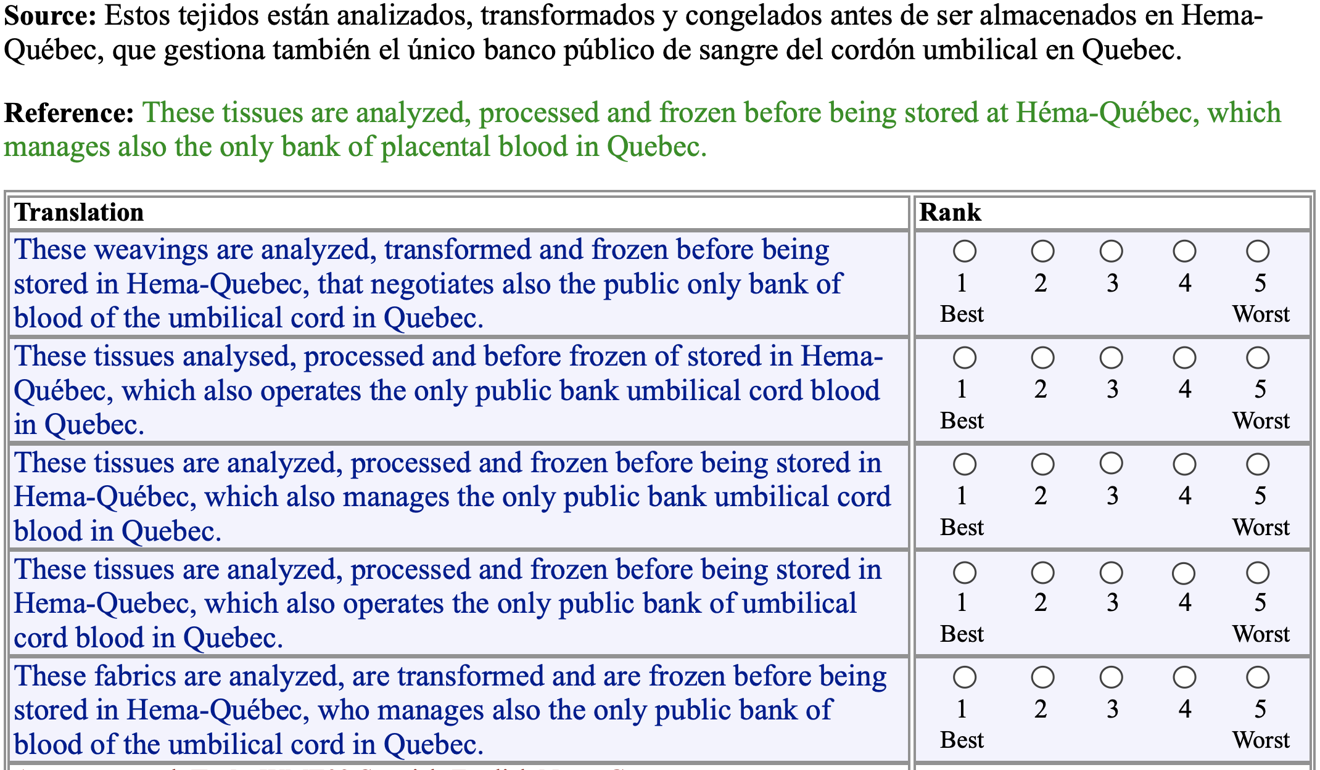
Manual Evaluation

Slide 53
Goals for
Automatic Evaluation
No cost evaluation for incremental changes
Ability to rank systems
Ability to identify which sentences we're doing poorly on, and categorize errors
Correlation with human judgments
Interpretability of the score

Slide 54
Methodology
Comparison against reference translations
Intuition: closer we get to human translations, the better we're doing
Could use WER like in speech recognition?

Slide 55
Word Error Rate
Levenshtein Distance (also known as "edit distance")
Minimum number of insertions, substitutions, and deletions needed to transform one string into another
Useful measure in speech recognition
This shows how easy it is to recognize speech
This shows how easy it is to wreck a nice beach
Notes:
Unlike translation, speech recognition is easy

Slide 56
Problems with WER
Unlike speech recognition we don't have the assumption of exact match against the reference or linearity
In MT there can be many possible (and equally valid) ways of translating a sentence, and phrases can be rearranged.
Notes:
Different words can be used

Slide 57
Solutions
/
Compare against lots of test sentences
1
Use multiple reference translations for each test sentence
2
Look for phrase / n-gram matches, allow movement
3

Slide 58
BLEU
BiLingual Evaluation Understudy
Uses multiple reference translations
Look for n-grams that occur anywhere in the sentence

Slide 59
Multiple references
Ref 1 | Orejuela appeared calm as he was led to the American plane which will take him to Miami, Florida.
Ref 2 | Orejuela appeared calm while being escorted to the plane that would take him to Miami, Florida.
Ref 3 | Orejuela appeared calm as he was being led to the American plane that was to carry him to Miami in Florida.
Ref 4 | Orejuela seemed quite calm as he was being led to the American plane that would take him to Miami in Florida.

Slide 60
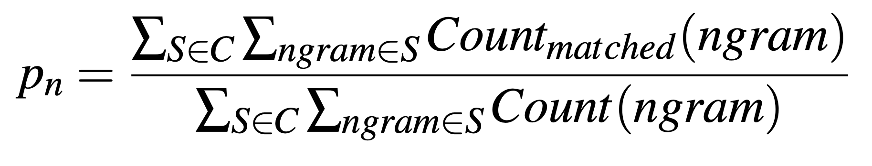
n-gram precision
BLEU modifies this precision to eliminate repetitions that occur across sentences.

Slide 61
Multiple references
Ref 1 | Orejuela appeared calm as he was led to the American plane which will take him to Miami, Florida.
Ref 2 | Orejuela appeared calm while being escorted to the plane that would take him to Miami, Florida.
Ref 3 | Orejuela appeared calm as he was being led to the American plane that was to carry him to Miami in Florida.
Ref 4 | Orejuela seemed quite calm as he was being led to the American plane that would take him in Florida. to Miami
“to Miami” can only be counted as correct once

Slide 62
Ref 1 | Orejuela appeared calm as he was led to the American plane which will take him to Miami, Florida.
Ref 2 | Orejuela appeared calm while being escorted to the plane that would take him to Miami, Florida.
Ref 3 | Orejuela appeared calm as he was being led to the American plane that was to carry him to Miami in Florida.
Ref 4 | Orejuela seemed quite calm as he was being led to the American plane that would take him to Miami in Florida.
Hyp | appeared calm when he was taken to the American plane, which will to Miami, Florida.

Slide 63
American, Florida, Miami, Orejuela, appeared, as, being, calm, carry, escorted, he, him, in, led, plane, quite, seemed, take, that, the, to, to, to, was , was, which, while, will, would, ,, .
1-gram precision = 15/18
Hyp | appeared calm when he was taken to the American plane , which will to Miami , Florida .

Slide 64
American plane, Florida ., Miami ,, Miami in, Orejuela appeared, Orejuela seemed, appeared calm, as he, being escorted, being led, calm as, calm while, carry him, escorted to, he was, him to, in Florida, led to, plane that, plane which, quite calm, seemed quite, take him, that was, that would, the American, the plane, to Miami, to carry, to the, was being, was led, was to, which will, while being, will take, would take, , Florida
2-gram precision = 10/17
Hyp | appeared calm when he was taken to the American plane , which will to Miami , Florida .

Slide 65
n-gram precision
Hyp | appeared calm when he was taken to the American plane, which will to Miami, Florida.
1-gram precision = 15/18 = .83
2-gram precision = 10/17 = .59
3-gram precision = 5/16 = .31
4-gram precision = 3/15 = .20
Geometric average
(0.83 * 0.59 * 0.31 * 0.2)^(1/4) = 0.417
or equivalently
exp(ln .83 + ln .59 + ln .31 + ln .2/4) = 0.417

Slide 66
Ref 1 | Orejuela appeared calm as he was led to the American plane which will take him to Miami, Florida.
Ref 2 | Orejuela appeared calm while being escorted to the plane that would take him to Miami, Florida.
Ref 3 | Orejuela appeared calm as he was being led to the American plane that was to carry him to Miami in Florida.
Ref 4 | Orejuela seemed quite calm as he was being led to the American plane that would take him to Miami in Florida.
Hyp | to the American plane

Slide 67
Is this better?
Hyp | to the American plane
1-gram precision = 4/4 = 1.0
2-gram precision = 3/3 = 1.0
3-gram precision = 2/2 = 1.0
4-gram precision = 1/1 = 1.0
exp(ln 1 + ln 1 + ln 1 + ln 1) = 1
Notes:
precision = correct / output-length
recall = correct / reference-length

Slide 68
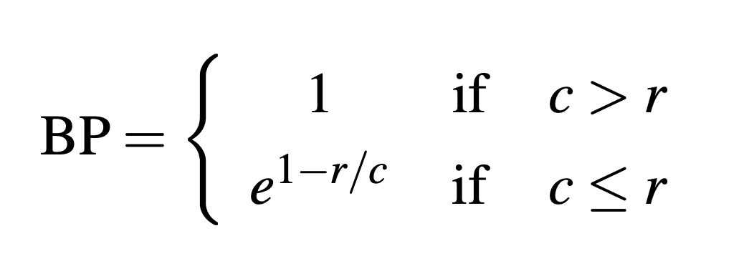
Brevity Penalty
c is the length of the corpus of hypothesis translations
r is the effective reference corpus length
The effective reference corpus length is the sum of the single reference translation from each set that is closest to the hypothesis translation.

Slide 69
Brevity Penalty
MT is Longer
MT is Shorter
Difference with effective reference length (%)

Slide 70
Ref 1 | Orejuela appeared calm as he was led to the American plane which will take him to Miami, Florida.
r = 20
Hyp | appeared calm when he was taken to the American plane, which will to Miami, Florida.
c = 18
BP = exp(1-(20/18)) = 0.89
Ref 1 | Orejuela appeared calm as he was led to the American plane which will take him to Miami, Florida.
r = 20
Hyp | to the American plane
c = 4
BP = exp(1-(20/4)) = 0.02

Slide 71
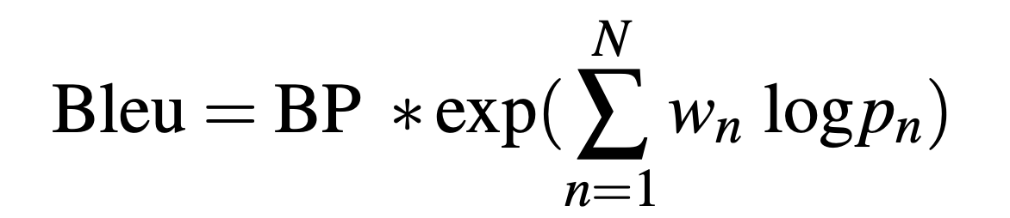
BLEU
Geometric average of the n-gram precisions
Optionally weight them with w
Multiplied by the brevity penalty
Notes:
exp = Exponent function = e^x

Slide 72
BLEU
Hyp | appeared calm when he was taken to the American plane, which will to Miami, Florida.
exp(1-(20/18)) * exp((ln .83 + ln .59 + ln .31 + ln .2)/4) = 0.374
Hyp | to the American plane
exp(1-(20/4)) * exp((ln 1 + ln 1 + ln 1 + ln 1)/4)
= 0.018

Slide 73
Problems with BLEU
Synonyms and paraphrases are only handled if they are in the set of multiple reference translations
The scores for words are equally weighted so missing out on content-bearing material brings no additional penalty.
The brevity penalty is a stop-gap measure to compensate for the fairly serious problem of not being able to calculate recall.

Slide 74
More Metrics
WER - word error rate
PI-WER - position independent WER
METEOR - Metric for Evaluation of Translation with Explicit ORdering
TERp - Translation Edit Rate plus

Slide 75
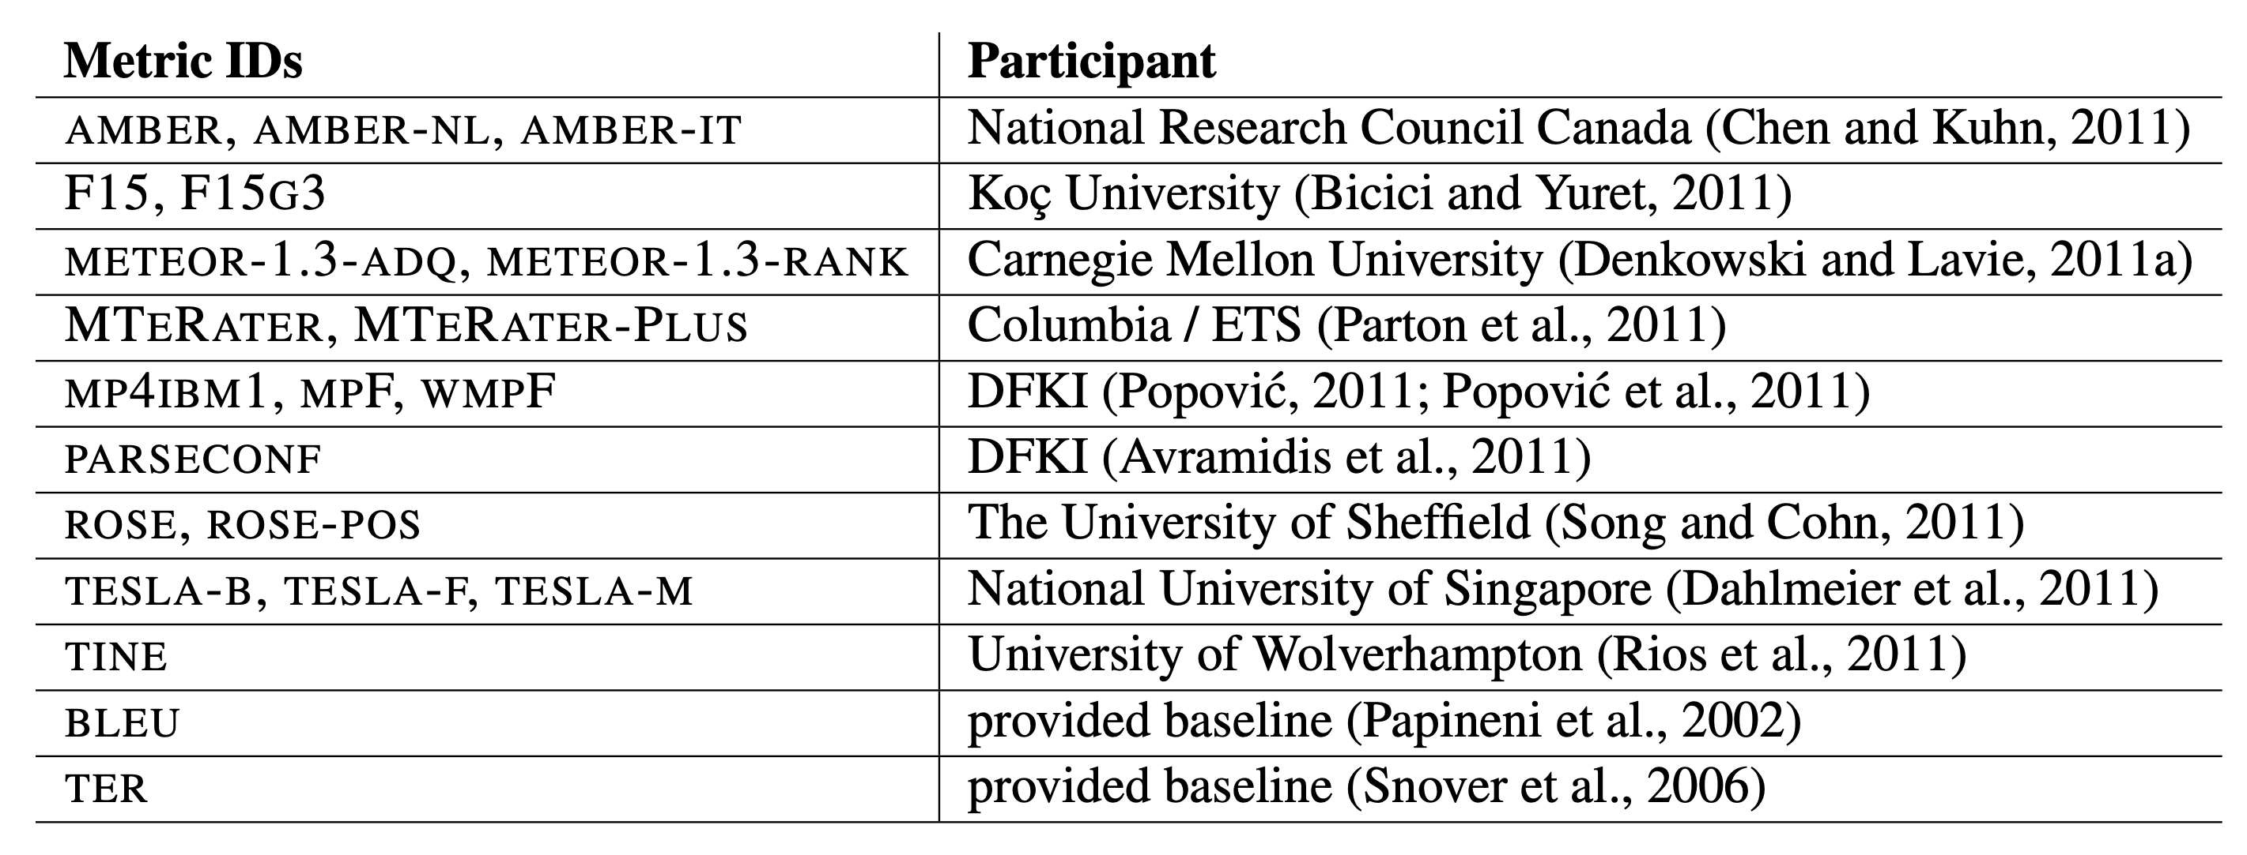
Even More Metrics

Slide 76
How do we know which metric is best?
Measure correlation with human judgments
How do people evaluation MT quality

Slide 77
Manual Evaluation

Slide 78
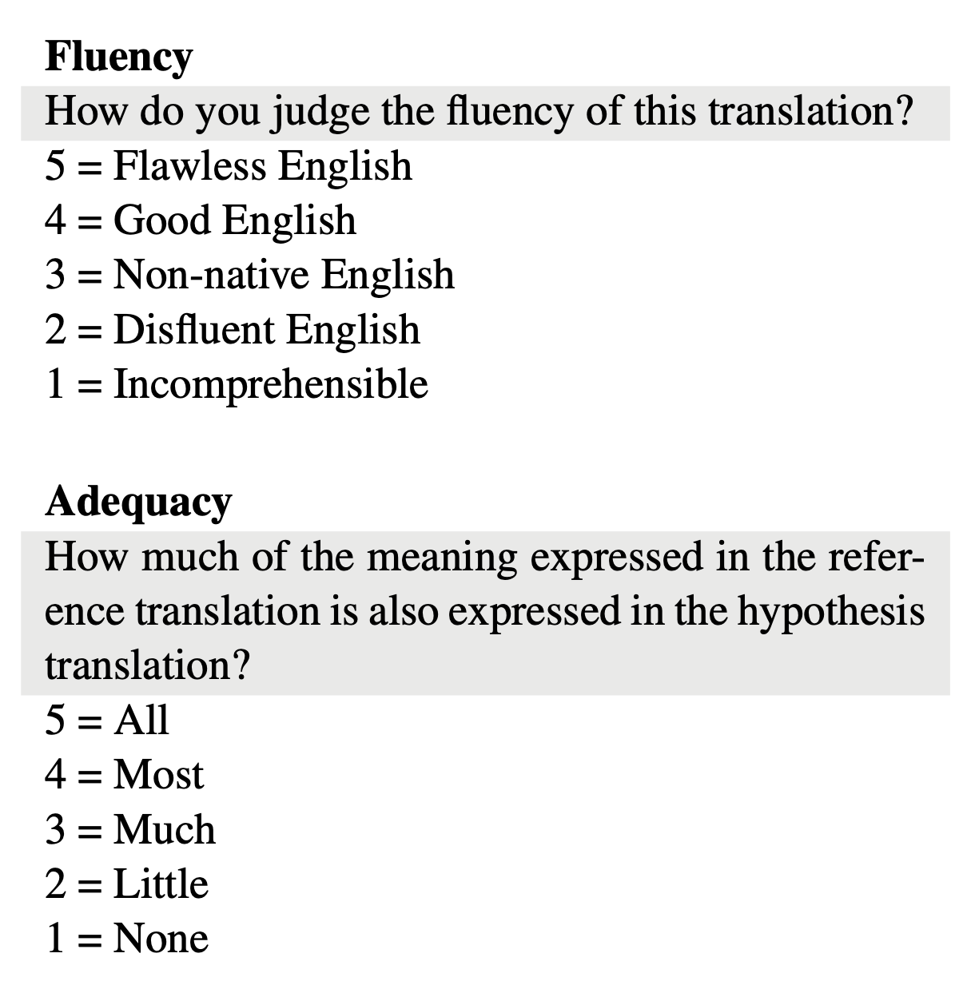
5-point scales

Slide 79
Basic Evaluation Paradigm
Use parallel test set
Use system to generate translations
Compare target translations w/ reference

Slide 80
Human Evaluation
Ask a human to do evaluation
Final goal, but slow, expensive, and sometimes inconsistent

Slide 81
BLEU
Works by comparing n-gram overlap w/ reference
Pros: Easy to use, good for measuring system improvement
Cons: Often doesn’t match human eval, bad for comparing very different systems

Slide 82
Other Options
METEOR: Considers synonyms
Translation Edit Rate (TER): Considers number of edits to be turned into a good translation
chrF: Considers score on the character level
RIBES: Considers reordering
etc. etc.

Slide 83
Attention

Slide 84
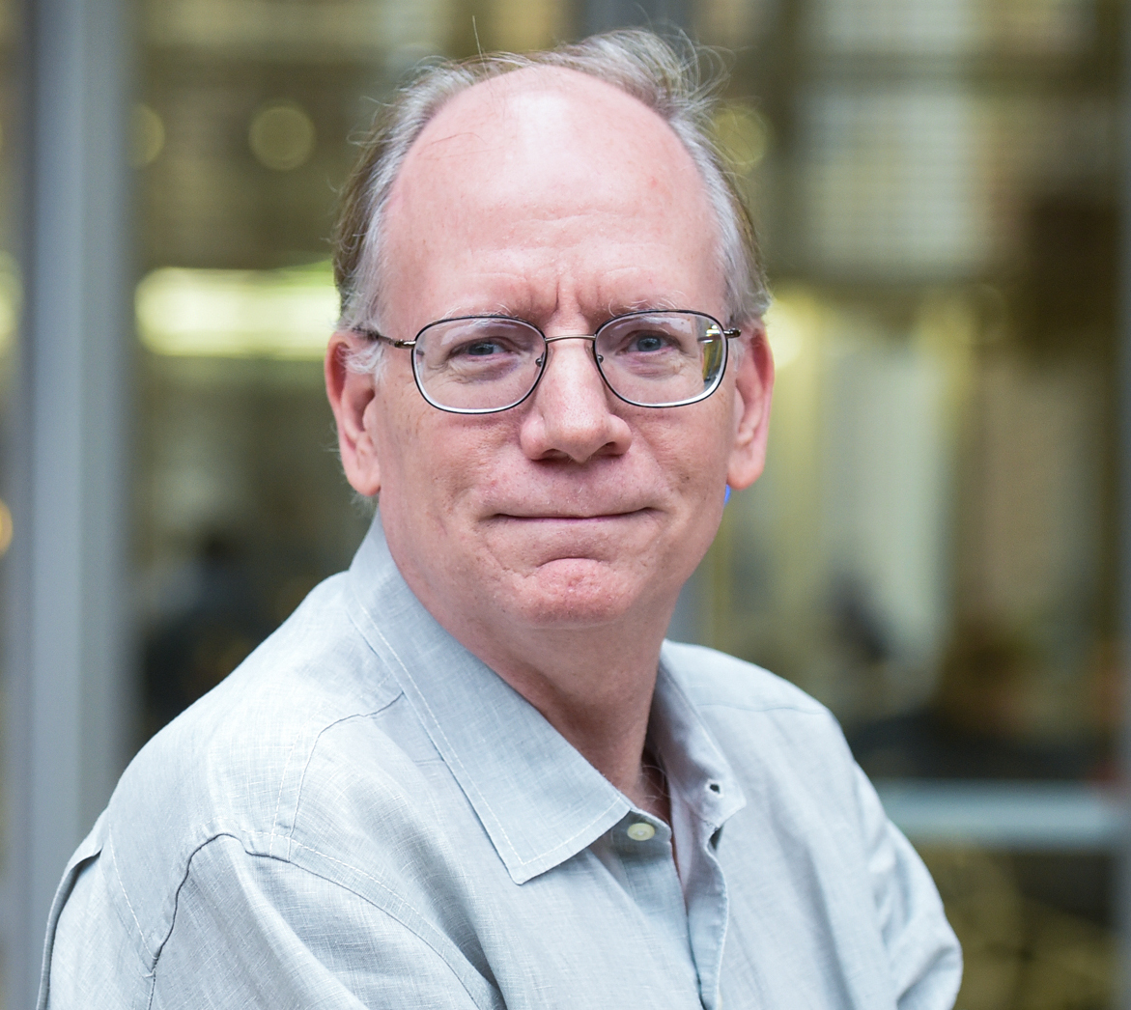
Sentence Representations
You can't cram the meaning of a whole %&!$# sentence into a single $&!#* vector!

Slide 85
Sentence Representations
But what if we could use multiple vectors, based on the length of the sentence?
this is an example
this is an example

Slide 86
Basic Idea
Encode each word in the sentence into a vector
When decoding, perform a linear combination of these vectors, weighted by “attention weights”
Use this combination in picking the next word
Neural Machine Translation by Jointly Learning to Align and Translate
by Dzmitry Bahdanau, Kyunghyun Cho, Yoshua Bengio, 2015

Slide 87
Encoder Bi-RNNs
A simple extension, run the RNN in both directions
I
hate
this
movie
RNN
RNN
RNN
RNN
RNN
RNN
RNN
RNN
concat
concat
concat
concat

Slide 88


Calculating Attention (1)
Use “query” vector (decoder state) and “key” vectors (all encoder states)
For each query-key pair, calculate weight
Normalize to add to one using softmax
kono
eiga
ga
kirai
Key
Vectors
I
hate
a1=2.1
a2=-0.1
a3=0.3
a4=-1.0
softmax
Query Vector
α1=0.76
α2=0.08
α3=0.13
α4=0.03

Slide 89

Calculating Attention (2)
Combine together value vectors (usually encoder states, like key vectors) by taking the weighted sum
kono
eiga
ga
kirai
Value
Vectors
*
*
*
*
α1=0.76
α2=0.08
α3=0.13
α4=0.03
Use this in any part of the model you like

Slide 90
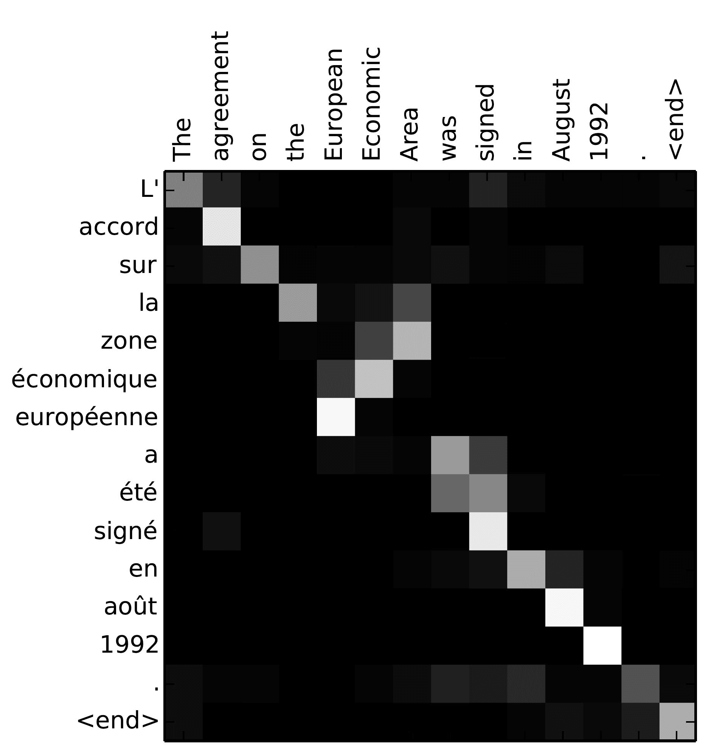
A Graphical Example

Slide 91
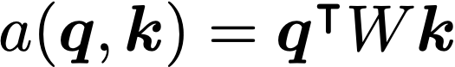
Attention Score Functions (1)
q is the query and k is the key
Multi-layer Perceptron (Bahdanau et al. 2015)
Flexible, often very good with large data
Bilinear (Luong et al. 2015)

Slide 92
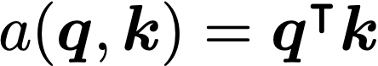
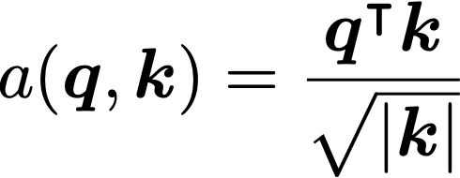
Attention Score Functions (2)
Dot Product (Luong et al. 2015)
No parameters! But requires sizes to be the same.
Scaled Dot Product (Vaswani et al. 2017)
Problem: scale of dot product increases as dimensions get larger
Fix: scale by size of the vector

Slide 93
Extensions to Attention

Slide 94
Intra-Attention / Self Attention
(Cheng et al. 2016)
Each element in the sentence attends to other elements → context sensitive encodings!
this
is
an
example
this
is
an
example

Slide 95
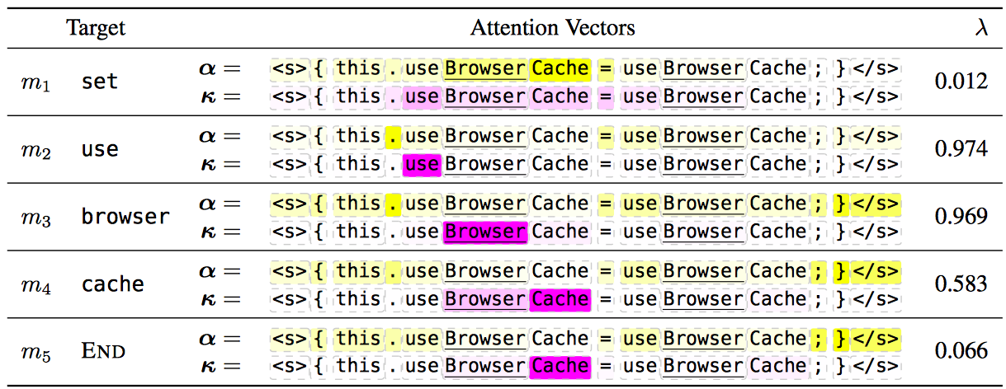
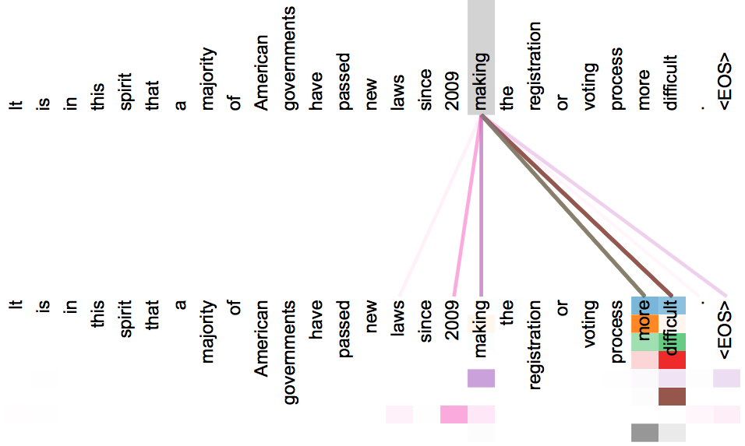
Multi-headed Attention
Idea: multiple attention “heads” focus on different parts of the sentence
e.g. Different heads for “copy” vs regular (Allamanis et al. 2016)
Or multiple independently learned heads (Vaswani et al. 2017)
Or one head for every hidden node! (Choi et al. 2018)

Slide 96
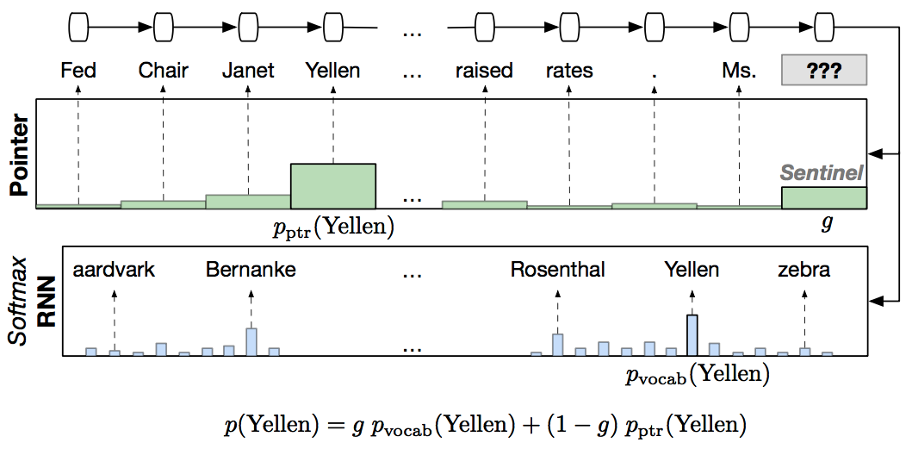
Attending to Previously Generated Things
In language modeling, attend to the previous words (Merity et al. 2016)
In translation, attend to either input or previous output (Vaswani et al. 2017)

Slide 97
An Interesting Case Study:
“Attention is All You Need”
(Vaswani et al. 2017)

Slide 98
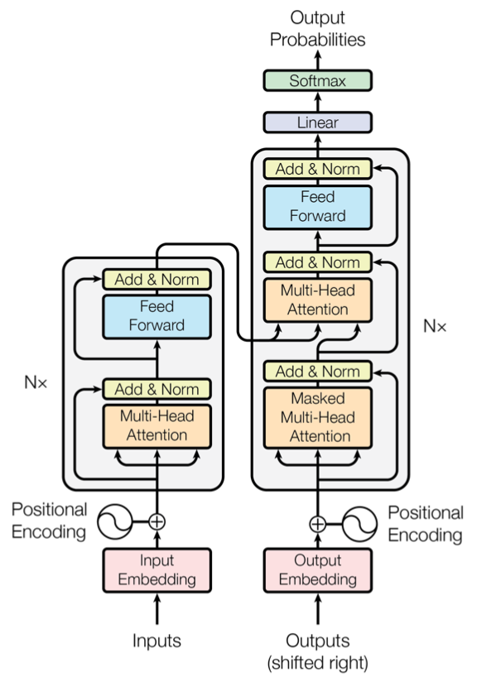
Summary of the “Transformer"
(Vaswani et al. 2017)
A sequence-to-sequence model based entirely on attention
Also have attention on the output side! Calculate probability of next word by attention over previous words.
Fast: only matrix multiplications

Slide 99
Attention Tricks
Self Attention: Each layer combines words with others
Multi-headed Attention: 8 attention heads function independently
Normalized Dot-product Attention: Remove bias in dot product when using large networks
Positional Encodings: Make sure that even if we don’t have RNN, can still distinguish positions

Slide 100
Training Tricks
Layer Normalization: Help ensure that layers remain in reasonable range
Specialized Training Schedule: Adjust default learning rate of the Adam optimizer
Label Smoothing: Insert some uncertainty in the training process
Masking for Efficient Training

Slide 101
Masking for Training
We want to perform training in as few operations as possible using big matrix multiplies
We can do so by “masking” the results for the output
kono
eiga
ga
kirai
I
hate
this
movie
</s>

Slide 102
How to Get Started?

Slide 103
Getting Started
Find training data, (e.g. TED talks from IWSLT), in your favorite language
Download a toolkit (e.g. OpenNMT, fairseq, Sockeye, xnmt) and run it on the data
Calculate the BLEU score and look at the results
Think of what's going right, what's going wrong!

Slide 104
Questions?
To Learn More: "Neural Machine Translation and
Sequence-to-sequence Models: A Tutorial"

